Slide 1
Sales Analysis
Project Name: Uncover Insights from Real Sales Data
Name: Uma Maheswari
Internship: Data Analyst
Batch: MIP-DA-01

Slide 2
Agenda
Overview of SQL
SQL Commands
SQL Data Types
SQL Constraints
SQL Joins
SQL Functions
Schema
Data Descriptions
Question and Answers
Basic
Join
Advance

Slide 3
Overview of SQL
What is SQL: SQL, or Structured Query Language, is a programming language designed for managing and manipulating relational databases. It is a standardized language used for communication with and interaction with relational database management systems (RDBMS).
Purpose of SQL: SQL is primarily used for querying and manipulating data stored in relational databases. It allows users to perform various operations, such as retrieving data, updating records, inserting new data, and deleting data.

Slide 4
SQL Constraints
Constraints are used to limit the type of data that can go into a table.
Constraints can be specified when a table is created (with the CREATE TABLE statement) or after the table is created (with the ALTER TABLE statement).
We will focus on the following constraints:
NOT NULL
UNIQUE
PRIMARY KEY
FOREIGN KEY
CHECK
DEFAULT

Slide 5
SQL Commands
DDL(Data Definition Language)
CREATE - Create a new table in the user’s database schema
ALTER - To make changes in the table structure
DROP - deletes a column
Data Manipulation Language
INSERT - inserts new data into a database
UPDATE - updates data in a database
DELETE - deletes data from a database

Slide 6
SQL Commands
Data Query Language
SELECT - extract data from a database
Transaction Control Language
COMMIT - Permanently save data changes
ROLLBACK - to restore the databases
SAVEPOINT - Save the current point with the unique name in the processing of a transaction.
Data Control Language
Grant - Provide access on the database objects to the users.
Revoke - Allows you to remove or revoke previously granted permissions on a securable for a principal.

Slide 7
SQL Data Types
Numeric data types: NUMBER(L,D) or NUMERIC(L,D)
Character data types :
CHAR(L)
VARCHAR(L) or VARCHAR2(L)
Date and time data types : DATE
Timestamp
Interval

Slide 8
SQL JOINS
SQL joins are used to query data from two or more tables, based on a relationship between certain columns in these tables.
The JOIN keyword is used in an SQL statement to query data from two or more tables, based on a relationship between certain columns in these tables.
Tables in a database are often related to each other with keys.
A primary key is a column (or a combination of columns) with a unique value for each row. Each primary key value must be unique within the table. The purpose is to bind data together, across tables, without repeating all of the data in every table.
LEFT JOIN: Return all rows from the left table, even if there are no matches in the right table
RIGHT JOIN: Return all rows from the right table, even if there are no matches in the left table
FULL JOIN: Return rows when there is a match in one of the tables

Slide 9
SQL Functions
Aggregate functions (SUM, AVG, COUNT, MAX, MIN)
String functions (CONCAT, LENGTH, SUBSTRING)
Date functions (DATE, MONTH, YEAR)
Other commonly used functions
Examples for each function

Slide 10
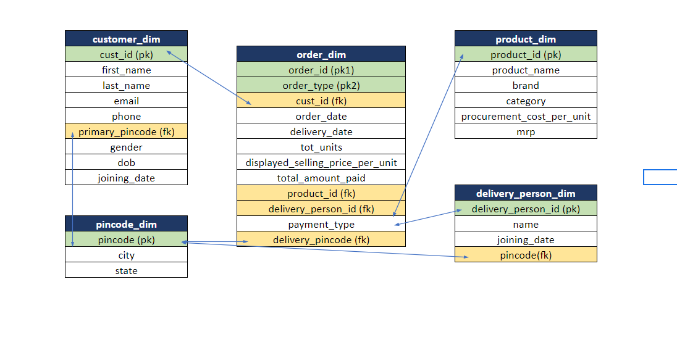
Schema

Slide 11
Database Description
Customers: Contains customer information, including cust_id, first_name, last_name, email, phone, primary_pincode, gender, dob, joining_date.
Products: Contains product information, including product_id, product_name, brand, category, procurement_cost_per_unit, mrp.
Pincode: Contains pincode-related information, including the pincode, city and state.
Delivery Person: Contains information about delivery personnel, including delivery_person_id, name, joining_date, pincode.
Orders: Contains order details, including order_id, order_type, cust_id, order_date, delivery_date, tot_units, displayed_selling_price_per_unit, total_amount_paid, product_id, delivery_person_id, payment_type, delivery_pincode.

Slide 12
Basic Questions
1. How many customers do not have DOB information available?
SELECT COUNT(*) AS NumberOfCustomersWithoutdob
FROM customers
WHERE dob IS NULL;
2. How many customers are there in each pincode and gender combination?
SELECT primary_pincode, gender, COUNT(*) AS NumberOfCustomers
FROM customers
GROUP BY primary_pincode, gender;

Slide 13
3. Print product name and mrp for products which have more than 50000 MRP?
SELECT product_name, mrp
FROM products
WHERE MRP > 50000;
4. How many delivery personal are there in each pincode?
SELECT Pincode, COUNT(delivery_person_id) AS numberofdeliveryperson
FROM delivery_person
GROUP BY pincode;

Slide 14
5. Print the Full names (first name plus last name) for customers that have email on "Gmail.com"?
SELECT CONCAT(first_name, ' ', last_name) AS full_name
FROM customers
WHERE email LIKE '%@gmail.com%';
6. Which pincode has average amount paid more than 150,000? Take only 'buy' order Types
SELECT pincode
FROM orders
WHERE order_type = 'buy'
GROUP BY pincode
HAVING AVG(total_amoun_paid) > 150000;

Slide 15
Joins Questions
11. How many units have been sold by each brand? Also get total returned units for each Brand?
SELECT s.brand,
SUM(s.units_sold) AS total_units_sold,
COALESCE(SUM(r.returned_units), 0) AS total_returned_units
FROM product
LEFT JOIN
returns_table r ON s.brand = r.brand
GROUP BY
s.brand;

Slide 16
12. How many distinct customers and delivery boys are there in each state?
SELECT
product_id,
COUNT(DISTINCT customer_id) AS distinct_customers,
COUNT(DISTINCT delivery_person_id) AS distinct_delivery_person_id
FROM
orders
GROUP BY
product_id;

Slide 17
Advance Questions
Using the per unit procurement cost in product_dim, find which product category has made the most profit in both absolute amount and percentage,Absolute Profit = Total Amt Sold -Total Procurement Cost Percentage Profit = 100.0 * Total Amt Sold / Total Procurement Cost - 100?
SELECT pc.category, SUM(o.total_amount_paid - (sf.quantity_sold * pd.procurement_cost_per_unit)) AS absolute_profit, 100.0 * SUM(o.total_amount_paid) / SUM(o.quantity_sold * pd.procurement_cost_per_unit) - 100.0 AS percentage_profit
FROM orders o JOIN product_dim pd ON o.product_id = pd.product_id JOIN product_category_dim pc ON pd.product_id = pc.product_id
GROUP BY pc.category
ORDER BY absolute_profit DESC;

Slide 18


